Slide 1


JODHPUR INSTITUTE OF ENGINEERING AND TECHNOLOGY,
JODHPUR.
Team members
ROHIT KANSARA
PRAKHAR CHAUHAN
SHUBHAM CHANDANI
PRAVEEN KANSARA
Team Name – SERVER MONKS

Slide 2
Sign Language
to
text/voice

Slide 3
Background
ISL is still not efficient way of communication among deaf community as not every deaf/dumb knows Sign Language.
Communication between Hearing person and Deaf person is still not easier as it requires involvement of third party.
Thus they are pressured to adopt written English as second language.

Slide 4
Objective
To build a prototype which could convert Sign Language to text or voice.
A device which could bridge the gap between hearing community and deaf community without use of third party while using their first language.

Slide 5
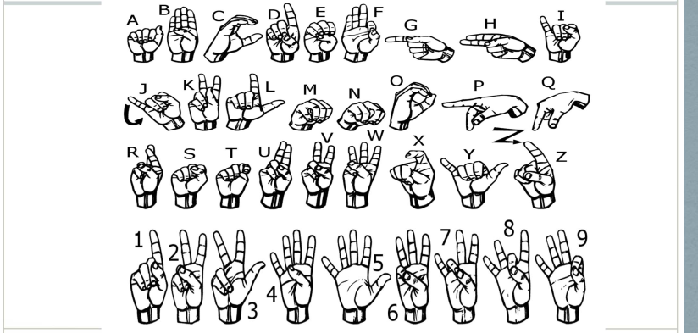
Alphabets and Numbers in ASL

Slide 6
Technical Approach
Setup
A device with camera and display or speak which shows text or convert into speech.
Interface
Camera captures the image/video of user’s gesture and then convert into text which is displayed on the screen or convert into voice.

Slide 7
Technical Approach
Algorithm
Image Processing : Capture the images as an input into convert into simpler and smaller vector.
Machine Learning: Thus those vectors are input to the machine learning algorithms which map those vectors and predict what class they vector belongs to and thus displays the output as text in display.

